Slide 1
LIFELINK
One Platform. Many Lives Saved.
AN INTEGRATED HEALTHCARE, DONATION, AND MEDICAL SERVICE PLATFORM

Slide 2

HEALTHCARE ACCESS IS FRAGMENTED WHEN TIME MATTERS
The right information is often spread across separate services.
01
Finding blood donors during emergencies is difficult.
02
Donation guidance, medical tests, medicines, and appointments live across separate services.
03
Prices and availability are hard to compare before a decision.
02

Slide 3
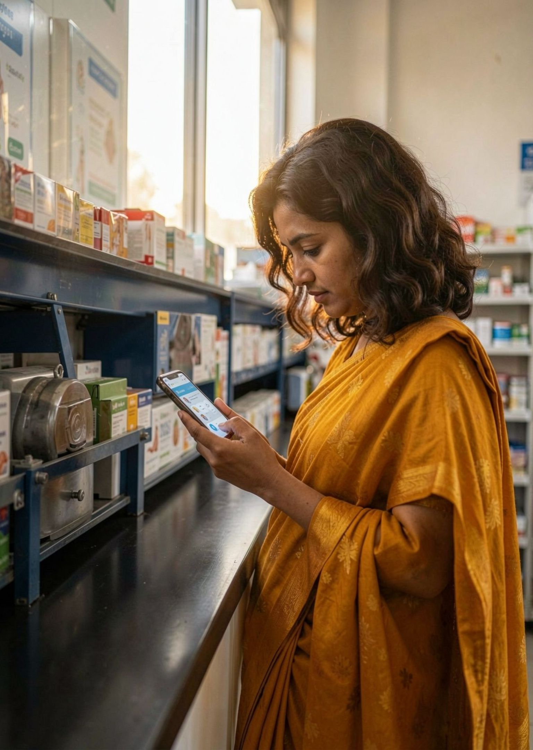




ONE ACCOUNT CONNECTS THE CARE JOURNEY
LifeLink brings discovery, requests, booking, and follow-up into one place.
Blood donor and recipient requests.
Official organ and tissue donation guidance.
Diagnostic and medicine price comparison.
Booking requests, notifications, and a personalized dashboard.
03

Slide 4


BLOOD REQUESTS BECOME A GUIDED MATCHING WORKFLOW
DONOR → RECIPIENT → VERIFIED CLINICAL CONNECTION
DONOR REGISTERS
REQUEST SUBMITTED
MATCH & SURFACE
NOTIFY & CONFIRM
Clinical confirmation happens with a verified blood bank or hospital.
04

Slide 5




DONATION GUIDANCE STARTS WITH INFORMED CONSENT
Explain organ and tissue donation, including heart, liver, lungs, kidneys, corneas, and eligible tissues.
Guide users to record intentions and official pledge services.
Connect families and authorized transplant coordinators with approved centres.
Organ allocation, suitability, consent verification, and transplantation follow applicable Indian laws and authorized medical procedures.
LifeLink is not an independent allocation system.
05

Slide 6
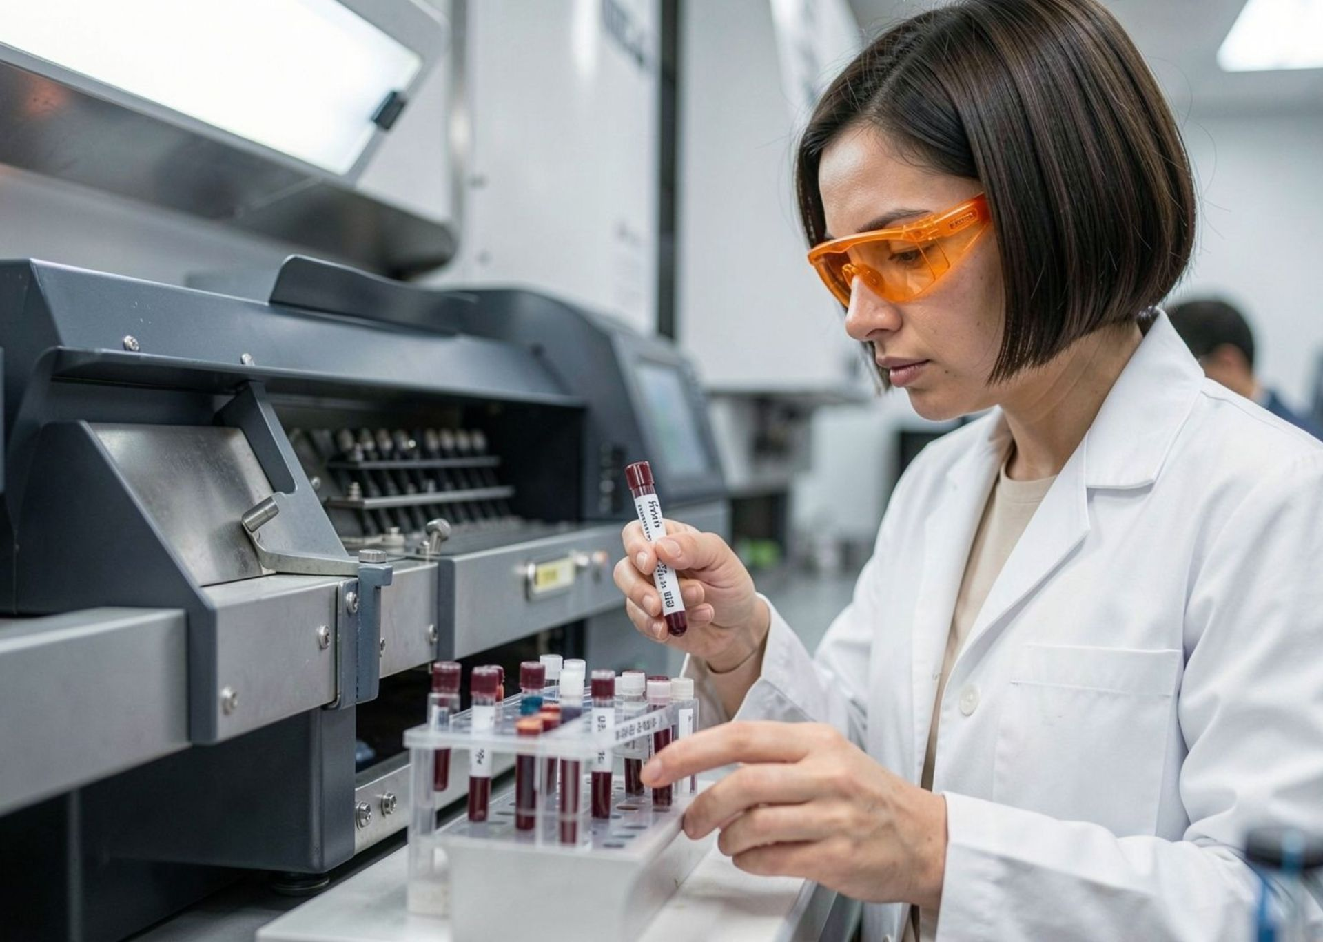
COMPARE MEDICAL SERVICES BEFORE YOU BOOK
ILLUSTRATIVE DIAGNOSTIC COMPARISON · SAMPLE DATA
TEST | PROVIDER | SAMPLE PRICE | DISTANCE | SLOT
CBC | Sample Lab A | ₹350 (sample) | 2.1 km | 10:30 AM
CBC | Sample Lab B | ₹480 (sample) | 4.8 km | 12:00 PM
Thyroid panel | Sample Lab C | ₹650 (sample) | 3.4 km | Tomorrow
Compare blood tests, CBC, thyroid tests, MRI, CT, and other diagnostics. Show sample prices, provider, location, distance, reviews, ratings, and appointment slots. Prototype values are sample data, not live market data.
06

Slide 7
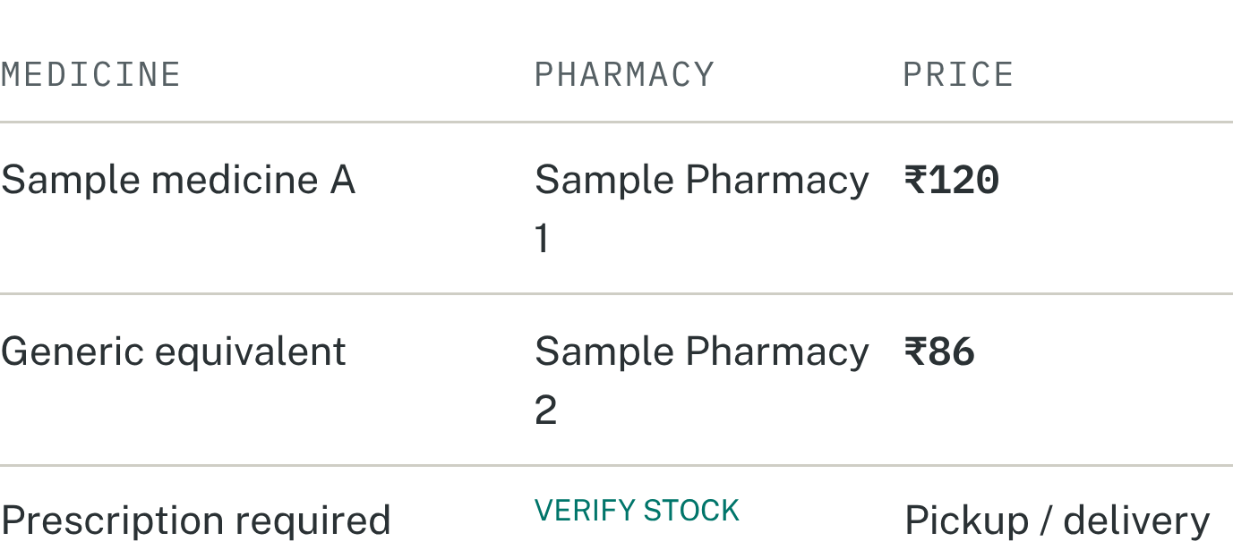



SAMPLE DATA
MEDICINE DISCOVERY BECOMES CLEARER AND SAFER
Pharmacy comparison
Compare medicine name, generic name, composition, strength, dosage form, pack size, and price.
FICTIONAL INFORMATION · PROTOTYPE SCREEN
Show verified pharmacy location, stock availability, and pickup or delivery options.
Compare equivalent medicines accurately and follow prescription requirements.
07

Slide 8
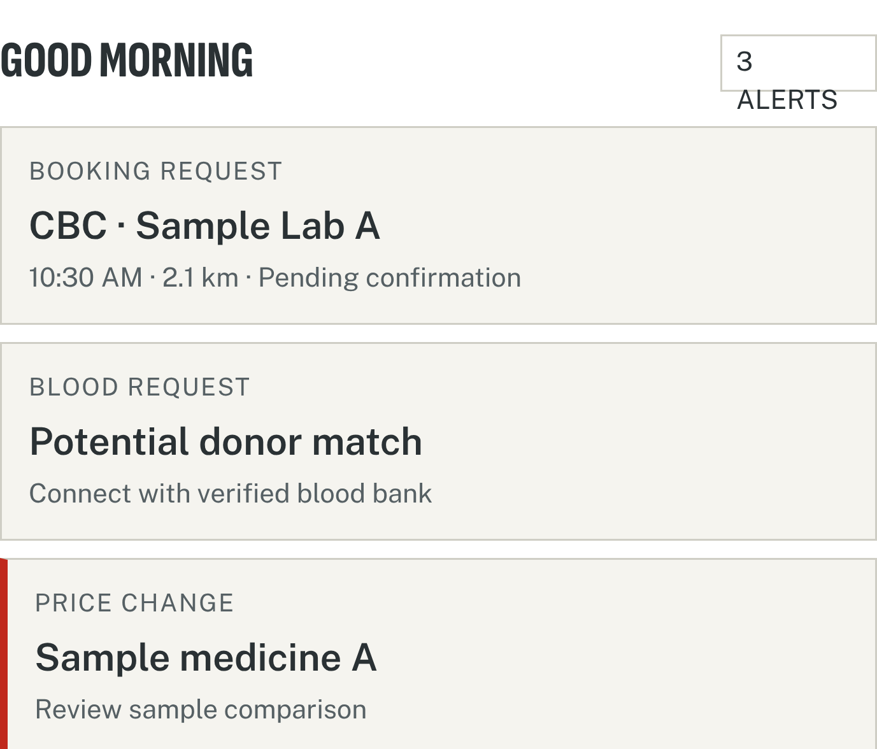



PROTOTYPE DASHBOARD
APPOINTMENTS AND ALERTS STAY IN ONE PLACE
Search, compare, request, and track the next step from one dashboard.
Search hospitals, diagnostic laboratories, and medical services.
Compare providers and available slots, then submit a booking request.
Track confirmations, cancellations, reports, blood requests, pledge confirmations, and price changes from one dashboard.
FICTIONAL INFORMATION · PROTOTYPE SCREEN
Real-time booking requires provider partnerships or approved integrations.
08

Slide 9

BUILT AS A CONNECTED, PRIVACY-AWARE PLATFORM
Maps, notifications, hosting, and future provider integrations complete the service layer.
USER INTERFACE
BACKEND API
DATA & AUTH
INTEGRATIONS
USER INTERFACE
BACKEND API
DATA + AUTHENTICATION
React · Tailwind CSS
Node.js · Express
PostgreSQL · Supabase · Supabase Auth
Privacy, consent, data protection, verification, and auditability are essential requirements.
09

Slide 10
START WITH A CREDIBLE MVP, THEN SCALE THROUGH VERIFIED PARTNERS
MVP
Verified integrations
Expansion
Registration, donor profiles, recipient requests, sample-data comparison, booking dashboard, and basic notifications.
Provider dashboards, real prices, genuine reviews, appointment connections, and pharmacy listings.
Official organ donation services, authorized transplant-centre discovery, more partners, and personalized service discovery.
Better access, informed choices, stronger donation networks, and more connected care.
ONE PLATFORM. BETTER ACCESS. INFORMED CHOICES. MORE LIVES CONNECTED.

